Slide 1






M5: Mastering Page Migration and Memory Management for CXL-based Tiered Memory System
¹Yan Sun, ¹Jongyul Kim, ¹Zeduo Yu, ¹Jiyuan Zhang, ¹Siyuan Chai, ³Michael Jaemin Kim, ³Hwayong Nam,
³Jaehyun Park, ³Eojin Na, ²Yifan Yuan, ²Ren Wang, ³Jung Ho Ahn, ¹Tianyin Xu, ¹Nam Sung Kim
¹University of Illinois Urbana-Champaign
²Intel Labs
³Seoul National University
Notes:
Hi everyone, my name is Yan. I am from University of Illinois at Urbana Champaign. Today I will present our recent work M5 – Mastering Page Migration and Memory Management for CXL-based Tiered Memory System.
This is a collaboration between UIUC, Intel Labs, and Seoul National University.

Slide 2
CXL Memory
Cache on chip
CXL Locally attached memory
SSD
Locally attached storage
HDD Locally attached storage
DRAM Direct attached
Cost-effective, but higher latency
About 2-3x latency of DRAM
Much faster than SSD
Tiered memory
Hot data in DDR memory
Cold data in CXL memory
How to identify hot data?
Increasing latency and capacity
🔥
Increasing bandwidth
❄️
Notes:
CXL memory has been popular in the past few years.
It is designed to be a cost-effective way to scale memory. <click>
In terms of latency, it is about 2-3x higher than the directly attached DDR memory, <click>
But it is still much faster than the SSD. <click> <graphic>
Because of this latency difference,
a common approach is to use CXL memory as a capacity expander <click>
In this case, a memory tiering is formed,
By keeping hot data in the low-latency DDR memory <click>
while placing colder data in the CXL memory. <click>
But the natural question is,
how do we identify which data is hot and which is cold?
Next, I will walk through
how prior works have used the CPU
to track data hotness within the memory hierarchy.

Slide 3
CXL hot memory tracking
Hint fault
Linux AutoNUMA balancing
PTE access bit scanning
DAMON, Multi-Clock (HPCA’22)
CPU event sampling
Memtis (SOSP’23)
How good are they? 🤔
Notes:
<click> <fast> <ANB>
In Linux, the default way of eliminating cross-tier memory access, is through hint fault.
This is part of Linux AutoNUMA balancing, where
the system periodically unmaps regions of memory.
And when the application accesses those unmapped regions, a page fault occurs.
At that point, the system checks whether
the access happens crossing NUMA nodes.
If so, the data is migrated
to the NUMA node where the CPU resides.
While this helps to localize memory access, it comes at a cost of periodic minor page faults.
<click> <fast> <TLB>
The second way of identifying hot data, is by scanning the page table entry access bits.
These systems start by periodically clearing the access bit in the page table entry.
And upon a TLB miss, the hardware automatically set this bit.
By sampling these bits over time, the system gets a rough estimate of how frequently each page is accessed.
However, the accuracy of this method depends heavily on the sampling rate.
Higher sampling rates improve accuracy,
but they also increase CPU overhead and TLB misses.
<click> <fast>
Finally, another line of work uses CPU event sampling to capture memory access addresses.
But again, the trade-off is here similar:
That we can get a limited accuracy at low sampling rates,
And have performance penalties at high sampling rate
With these software-based solutions in mind, our first step
was to evaluate how accurate they are
in detecting hot pages.

Slide 4
Oracle tracking
Ground truth for hotness
On path hardware unit
Monitor all memory access
Page access tracking (PAC)
Count access to each page
Word access tracking (WAC)
Count access to each 64B word
Pages can be sparsely accessed
CPU
Core
LLC
CXL device
Table
CL, +1
PFN, +1
Counter
15
16
CXL memory
Notes:
To evaluate the accuracy of software-based hotness tracking,
we first built a hardware oracle tracker
which serves as the ground truth for memory access patterns.
<click>
We implemented this tracker on a CXL-enabled FPGA, which monitors EVERY memory access to the CXL memory.
<click>
For Page Access Count tracker, or PAC, we maintain one counter per 4KB page in the CXL memory.
Each time a page is accessed, its corresponding counter is incremented.
This gives us an exact count of how frequently each page is accessed.
And this output will lets us directly compare the page-level hotness
detected by software
with the ground truth from hardware.
<click>
To go even deeper, we also implement Word Access Count tracker, or WAC.
Here, we maintain a counter for each 64 byte word.
The WAC results show us how access patterns are distributed within each page—
which helps identify aonther issue, migration amplification,
where a page is migrated due to a small number of hot words.

Slide 5
CPU tracking
How good is the tracking?
Scheme picked vs. Oracle picked (avg < 40% accurate)
Amplification
Word access counter (WAC)
Sparsely accessed (Redis)
50% page have < 4 CL accessed
Overhead
Increase kCPU cycle by 159% and 277%
Notes:
So how well do existing tracking methods perform?
To answer that, we evaluated Page Access Count tracker against two software-based approaches:
Linux AutoNUMA balancing, or ANB
and DAMON, the state-of-the-art implementation of PTE-scanning.
<click>
<click> <red circle>
Across our benchmark suite, PAC revealed that both schemes achieved less than 40% accuracy, on average, in identifying the hottest pages.
<click>
We further use Word Access Count tracker on these applications.
The graph shows a cumulative distribution function (CDF) of the number of 64 Byte words being accessed in a 4KB page.
For example, in Redis, we observed that over 50% of pages had fewer than four cache lines accessed.
This shows a high potential for migration amplification,
where cold pages can be moved just because of a few active words.
<click>
And finally, the runtime cost is significant:
On average, ANB and DAMON increase kernel CPU cycle utilization by 159% and 277%, respectively.

Slide 6










Highly accurate hardware tracking
Track at various granularity
No tracking overhead, fully CXL-driven
Limited accuracy in hot page identification
Can lead to amplified page migration
High CPU utilization
M5
Mastering Memory Management & Page Migration in
CXL-Based Tiered Memory System
Notes:
In summary, CPU-based hotness tracking methods
face several fundamental challenges
First, base on our profiling, they can achieve limited accuracy.
<click>
Second, CPU-based schemes cannot effectively identify densely accessed hot pages,
and thus can incur amplification when a sparsely accessed page is migrated.
Third, the overhead of these tracking systems is non-trivial,
and can significantly increasing CPU utilization.
In this work, we make the following contribution:
---
First, we propose a CXL-driven solution that tracks with high accuracy.
Second, the proposed tracking solution can track at various granularity, overcoming the issue of migration amplification.
And finally, since the tracking is done completely in hardware, the overhead is thus minimized.
We present M5, mastering memory management AND page migration in CXL-based Tiered Memory system.

Slide 7

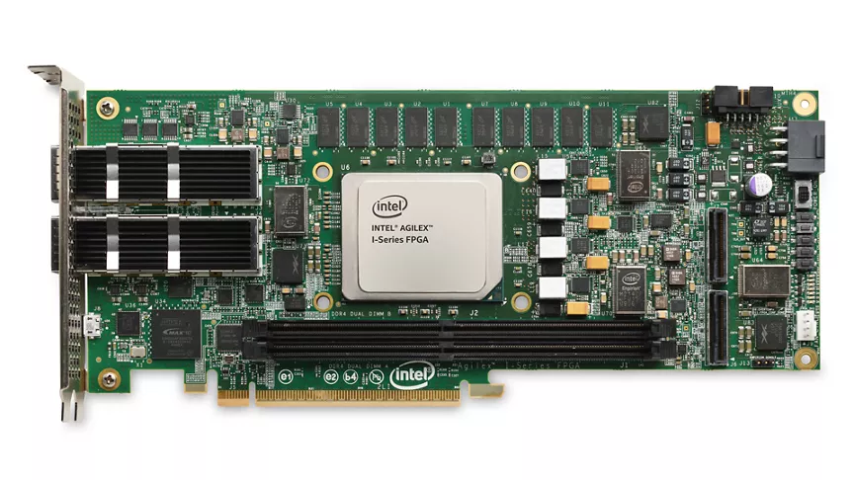
M5 scheme
Near memory tracking
Monitor LLC miss to CXL
CXL FPGA
Tracking on the data path
CM-sketch / Space-saving
Software controller
Control tracker output rate
System monitoring
Issue page migration
CPU
SW Controller
LLC
0x1FFF
0x3000
0x2567
0xECEB
CXL device
Tracker
DDR memory
Notes:
The core idea behind M5 is to track memory hotness close to the CXL memory itself. <click>
As LLC miss travel from the CPU to the CXL device,
M5 taps into that access path
to monitor memory addresses in real time. <click>
The memory addresses are then fed into a hardware tracking unit
that runs various tracking algorithms. <click>
On the software side, M5 includes a lightweight runtime, where it:
Controls the output rate from the hardware tracker
Monitors system counters to inform migration decisions, and
Initiates page migration
Next, I’ll dive into the components of M5 in more detail.

Slide 8
M5 tracker
CPU
Input
LLC miss addresses
Address granularity
Page (4KB), Word (64B)
Output
Hot addresses, CXL BW
SW Controller
LLC
PFN, GB/s
CXL device
Tracker
CXL memory
Notes:
First, let’s take a closer look at the hardware tracker.
<click>
The input to the tracker consists of CPU LLC miss addresses that are headed toward CXL memory.
<click>
Within the CXL device, we have two independent trackers
where the hot page tracker takes the 4KB page address bits,
Or in another word, starting from bit 12 of the physical address
In the hot word tracker, we take the 64 bytes word addresses,
Which starts from bit 6 of the physical address.
<click>
The trackers then outputs two key pieces of information: hot memory addresses,
and the total access bandwidth to the CXL memory.

Slide 9
M5 tracker
Input
LLC miss addresses
Address granularity
Page (4KB), Word (64B)
Output
Hot addresses, CXL BW
Tracking algorithm
Space-saving, CM-Sketch
Notes:
Within the tracker, we tested two data streaming algorithms:
Space-saving. And CM-sketch.
Next I will give a brief example of how the CM-sketch works.
-- <click>
For the inputting address HEX E C E B,
The algorithm first input the address into a set of hash functions.
Each hash function will yield an independent index toward a counting table.
And the counting table will then increment the counter for the index at that particular column.
Once the counter is incremented,
we try to estimate the access count to this address
by picking the minimum count among the columns.
In this case, we estimated that the address HEX E C E B, has been accessed 16 times.
This estimation is then inputted into a content addressable memory module (CAM), with a sorting capability.
In this example, address count pair is inserted into the CAM
since it is larger than the pair with minimum value.

Slide 10
M5 tracker
Input
LLC miss addresses
Address granularity
Page (4KB), Word (64B)
Output
Hot addresses, CXL BW
Tracking algorithm
Space-saving, CM-Sketch
Tunable knobs
Control hot page output rate
Notes:
In this second example, where the inputting address is HEX One F F F,
The address again goes through a set of hash functions, to get an index for its column.
Note that 2 out of 5 index in this example collides with the prior example,
denote by the shaded couters.
But since we have 5 hashing functions, we can get our estimation from the other three entries,
Which in this case estimated that the address has been accessed 6 times.
Finally, the sorting CAM insert the address count pair by replacing the minimum pair.
<click> <click>
---
With this tracker implemented in the hardware, we exposes a knob to software,
to control the rate that we extract the hot pages from the CAM.
---
Next, I will introduce how we manage the hot addresses extracted from the tracker.

Slide 11
M5 Nominator
CL addr
PFN
Software fetching hot word / page
Hot word array (_HWA)
Hot page array (_HPA)
User specified scheme
Use _HWA only
Use _HPA only
Align the two
CPU
SW Controller
_HPA
_HWA
LLC
CL addr
PFN
CXL device
Tracker
CXL memory
Issue migration
Notes:
Once the hot addresses are generated by the hot word and hot page trackers…
The M5 Nominator stage stores them into two arrays: <click>
the hot word array (HWA)
and the hot page array (HPA). <click> <clikc>
The M5 Nominator is responsible for selecting which pages should be migrated between the two array.
In our study, we explored three simple policies for making this decision:
Using only the hot word array, <click>
Using only the hot page array, and <click>
Or Aligning both to select pages
that are hot in both the page level
and hot in the 64B word level. <click>
<NO CLICK>
Despite their simplicity, these policies were able to deliver high tracking accuracy.
Next I will introduce the monitor and the elector stage of M5.

Slide 12
M5 Monitor / Elector
Software control algo
Elector decides
How many pages should be migrated
Calculate “density”
Access per allocated byte
(GB/s) per (GB allocated)
We expect
Higher density in DDR
Lower density in CXL
CPU
SW Controller
D_cxl
D_ddr
D_cxl
D_cxl
D_ddr
D_ddr
BW CXL
BW DDR
BW CXL
BW CXL
BW DDR
BW DDR
LLC
Size CXL
Size CXL
Size CXL
Size DDR
Size DDR
Size DDR
CXL device
High CXL density
Matching density
Tracker
High DDR density
Set tracker rate
Set tracker rate
Set tracker rate
CXL memory
Output more address
Stabilize
Slow down
Notes:
The monitor and elector stage of M5 is responsible for controlling the output rate of the tracker.
Furthermore, they decide when the migration should stop,
For example, we should stop migration, when the fast-tier DDR memory becomes fully populated with hot data.
<click>
To detect this, the Monitor stage gathers both the memory bandwidth and allocated memory size for CXL and DDR. <click>
Then, the Elector stage calculates the access density for each tier, which we define as: memory bandwidth divided by allocated memory size.
Let me show you how this works in a brief example.
<click>
We started with the same amount of memory in both CXL and DDR, denoted in orange <click>
However, if we observed high memory bandwidth toward CXL,
and thus, high access density in CXL,
the Elector will tune the tracker to output more aggressively.
and therefore migrate more hot pages to DDR.
<click>
As we move more hot pages to DDR memory, the density of the two gradually stablelized. <click>
And when the access density in the DDR memory is much higher than that of CXL,
the Elector will gradually tune the tracker to output less hot addresses.
<NO click>
This will help reduce the issue of thrashing
where we constantly promoting and demoting pages between the two memory tier. <click>
Again, we expect a high access density in DDR memory, while a low density in the CXL memory.

Slide 13
M5 Promotor
Takes hot address
Convert & Checks
Convert PFN to Linux kernel data struct
Check if OK to migrate
Initiates page migration
Promote from CXL to DDR
Linux MGLRU
Demote from DDR to CXL
CPU
SW Controller
_HPA
_HWA
LLC
Get page structs
Migration checks
MGLRU
CXL device
Promote
Tracker
CXL memory
DDR memory
4KB
4KB
Notes:
Finally, in the Promoter stage, M5 takes the hot PFNs identified by the previous stage, and promote it from CXL memory to DDR memory.
<click>
<click>
It first finds the Linux kernel data structure for that page <click>
performs the necessary checks for migration <click>
And finally, initiates page migration to promote the hot page from CXL to DDR.
<click><click>
If the fast-tier DDR is already full, a page demotion is triggered,
Where the Linux Multi-Gen LRU (MGLRU) system selects a cold page,
And moved it from the DDR memory back to CXL memory

Slide 14
Put everything together – HW / SW co design
Nominator
Pick pages
Promotor
Move pages
Tracker
In CXL HW
Monitor
Sys statistics
Elector
Density / rate
Notes:
Putting everything together,
The M5 scheme starts by building hotness trackers in the CXL hardware.
<click>
The trackers output hot addresses to the nominator stage,
<click>
Where the page is further selected and handed toward the promotor stage for page migration.
<click>
At the mean time, the monitor stage checks on various system statistics,
And hand the data to the elector stage,
The Elector calculates the access density for DDR and CXL,
And controls the trackers for their rate of outputting hot pages

Slide 15
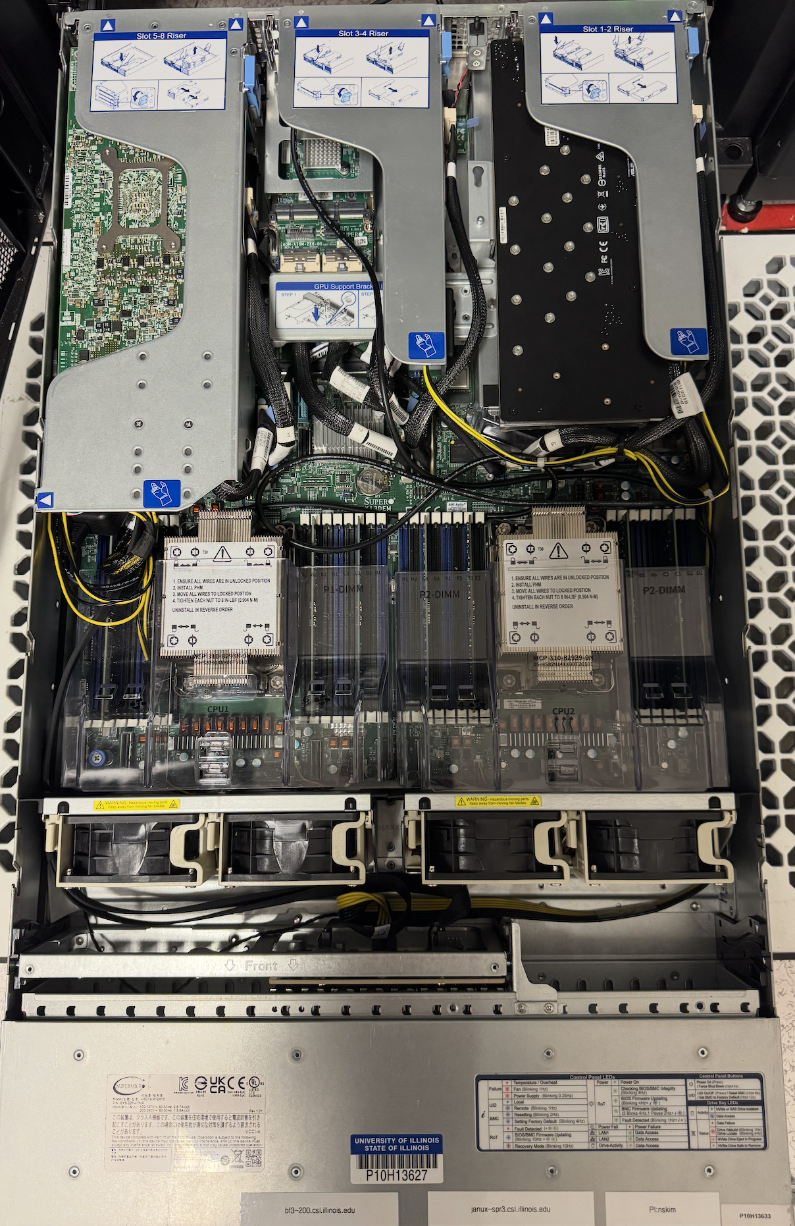
Methodology
CXL FPGA
Real system implementation
2 x Intel Xeon 6430 (SPR)
Intel Agilex I-seres FPGA
CM-sketch
FPGA: 128,309 ALM (14% util)
ASIC: 46,930 𝜇m² (7nm)
Benchmarks
Liblinear, GAPBs, SPEC2017, Redis
Intel SPR
Intel SPR
Notes:
The M5 system is tested on a CXL-ready platform,
Running with 4th gen Intel Xeon CPU,
And the M5 hardware tracker is built into an Intel Agilex 7 I-series FPGA. <V>
<click>
When testing with the CM-sketch algorithm, the hot page tracker takes around 14% of the FPGA resource,
and when we synthesize the design with 7nm process node,
the ASIC area is roughly 47 thousand micro-meter square.
On this platform, we tested our design with the following benchmarks
liblinear, which performs linear classification,
GAPBS, which performs a set of graph workload,
A subset of SPEC2017, that are memory bandwidth intensive
And finally in-memory database -- Redis

Slide 16
Evaluation
Testing accuracy with PAC
CPU best vs. M5
Algorithm accuracy
Space-saving (+43%)
CM-sketch (+47%)
No tracking overhead!
Tracking is done in hardware
Software consumes < 2% CPU
Notes:
To validate the tracking accuracy of our hardware design,
We ran the same oracle tracker (Page access counter), against M5 implementations using both Space-Saving and Count-Min Sketch.
<click>
When compared to the best CPU-driven tracking solution, shown in blue
the M5 hardware tracker, shown in red and green,
significantly outperforms the CPU solutions, across most tested benchmarks.
On average, M5 achieves 43% higher accuracy with Space-Saving,
and 47% higher accuracy with Count-Min Sketch.
And more importantly, this tracking is done with zero CPU overhead—
And rest of the M5 software runs in less than 2% of CPU cycle.

Slide 17
End to end performance
Baselines
All CXL
Comparison
ANB, DAMON
M5-HPT, M5-HWT, M5-HPT+HWT
M5 performance gain
Over ANB (+24%)
Over DAMON (+14%)
Notes:
With strong tracking accuracy across benchmarks, let’s now look at the end-to-end performance.
First, the performance are normalized to a baseline where the application runs entirely on CXL memory. <click>
<click>
We then compare several schemes:
With Linux AutoNUMA Balancing (ANB),
And Linux DAMON,
And with M5 using Hot Page Tracker (HPT),
using Hot Word Tracker (HWT),
And with a combination of both HPT and HWT.
<click>
Across the board, M5 outperforms the CPU-driven solutions in most benchmarks— delivering up to 24% performance gain over ANB, and 14% gain over DAMON."

Slide 18

Conclusion
Finding hot data in tiered memory
Hardware tracker
Low overhead, highly accurate
M5 improve by 14 - 24% over SOTA CPU tracking
All SW and HW are open-sourced!
Thank you : )
https://github.com/ece-fast-lab/ASPLOS-2025-M5
Notes:
In this work, we presented M5—a hardware-based hotness tracking mechanism for identifying frequently accessed memory in CXL systems.
M5 runs tracking algorithms directly on CXL hardware,
achieving a high accuracy with minimal overhead.
Our end-to-end evaluation shows that M5 delivers 14% to 24% performance improvement over state-of-the-art CPU-based tracking schemes.
All of our software and hardware are open-sourced. Thank you for listening, and I am happy to take questions.

Slide 19
Access distribution
CDF built with PAC
Access distribution count of pages
Half of memory is promoted
Blue dashed line
Skewed access
bc, liblinear, roms
Not worth migrating
tc – many pages untouched

